Slide 1


Unit VI: IP Subnetting
Computer Network 1
Facilitator: Frank
Course code: CS 8137
Email: frankibrahim25@gmail.com

Slide 2
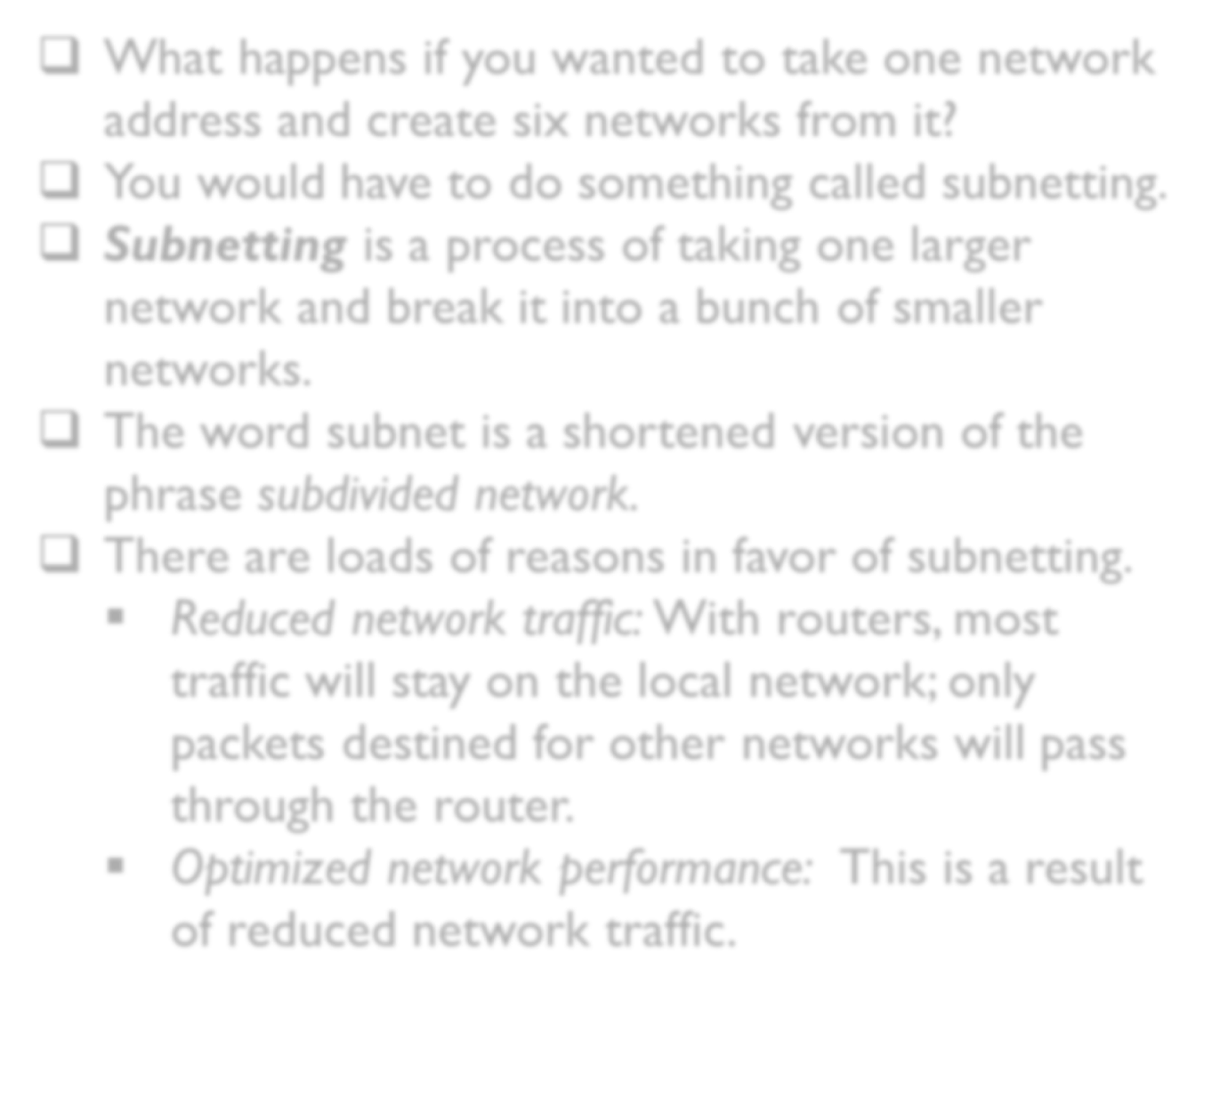
What happens if you wanted to take one network address and create six networks from it?
You would have to do something called subnetting.
Subnetting is a process of taking one larger network and break it into a bunch of smaller networks.
The word subnet is a shortened version of the phrase subdivided network.
There are loads of reasons in favor of subnetting.
  Reduced network traffic: With routers, most traffic will stay on the local network; only packets destined for other networks will pass through the router.
  Optimized network performance: This is a result of reduced network traffic.

Slide 3
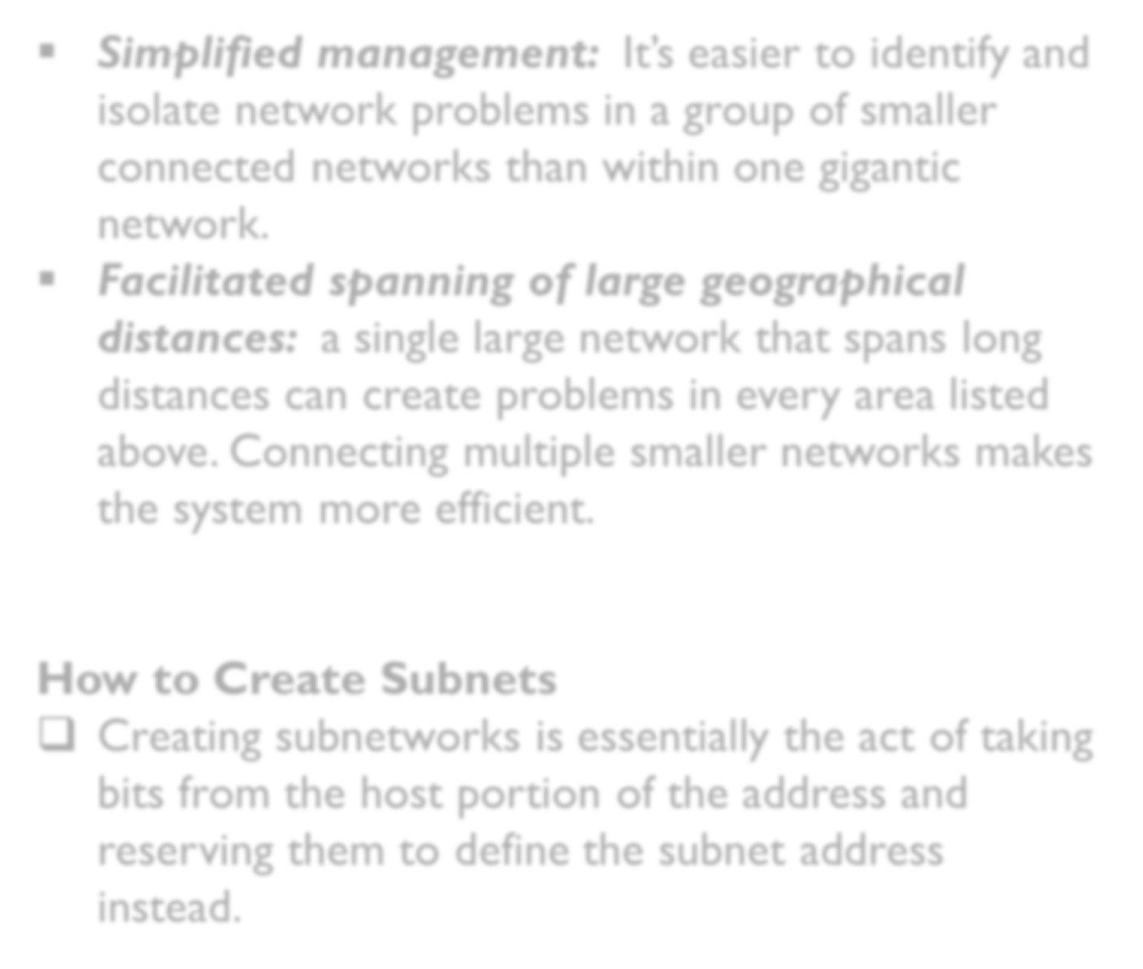
Simplified management: It’s easier to identify and isolate network problems in a group of smaller connected networks than within one gigantic network.
Facilitated spanning of large geographical distances: a single large network that spans long distances can create problems in every area listed above. Connecting multiple smaller networks makes the system more efficient.
How to Create Subnets
Creating subnetworks is essentially the act of taking bits from the host portion of the address and reserving them to define the subnet address instead.

Slide 4
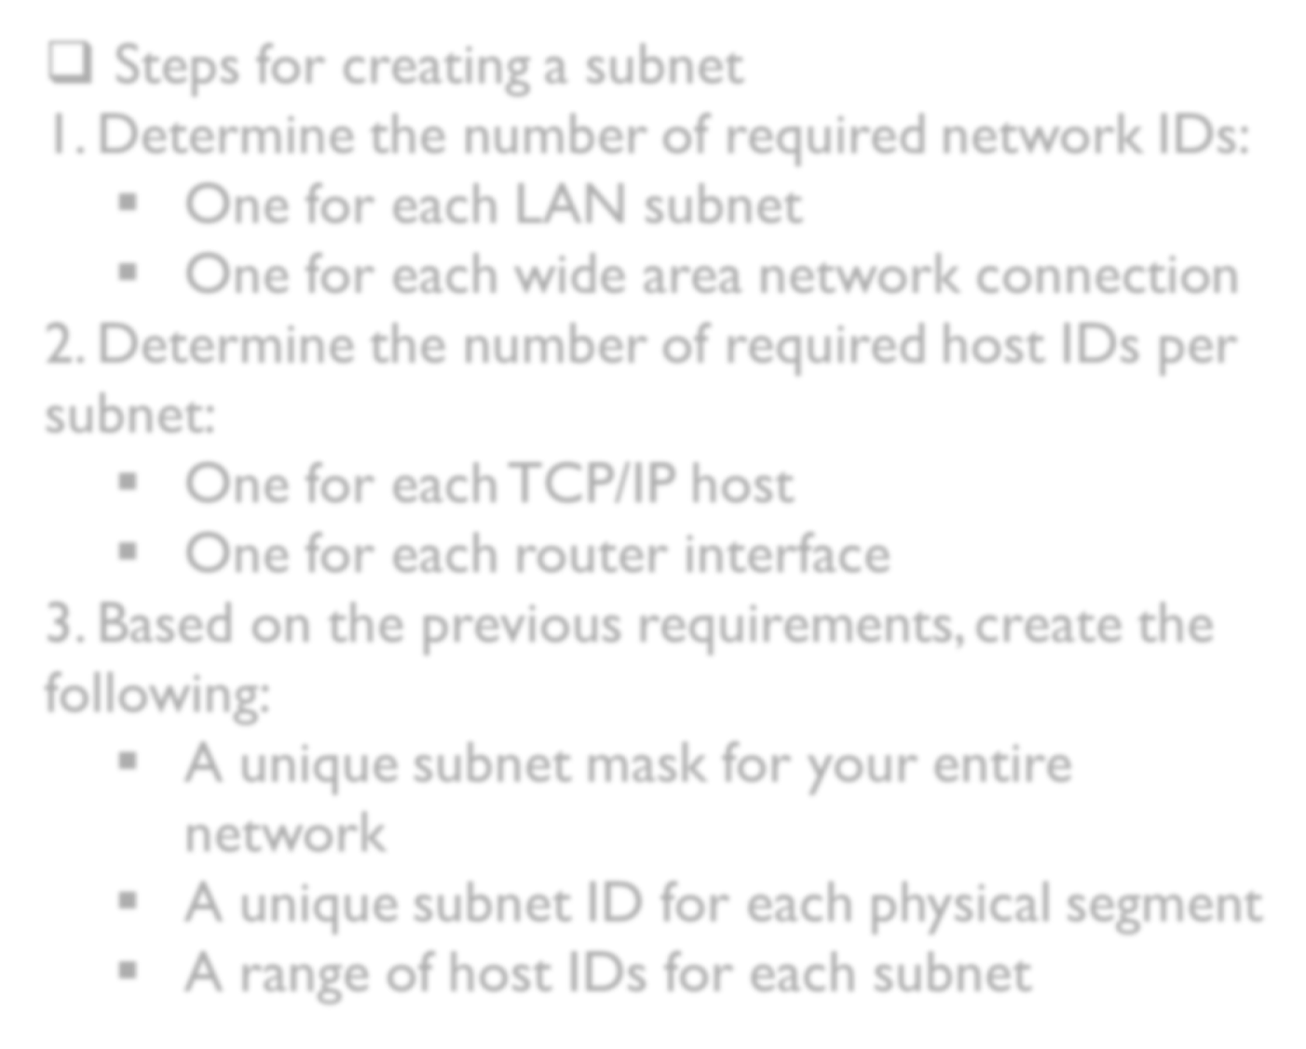
Steps for creating a subnet
1. Determine the number of required network IDs:
  One for each LAN subnet
  One for each wide area network connection
2. Determine the number of required host IDs per subnet:
  One for each TCP/IP host
  One for each router interface
3. Based on the previous requirements, create the following:
  A unique subnet mask for your entire network
  A unique subnet ID for each physical segment
  A range of host IDs for each subnet

Slide 5
Subnet Masks
For the subnet address scheme to work, every machine on the network must know which part of the host address will be used as the subnet address.
This condition is met by assigning a subnet mask to each machine.
A subnet mask is a 32-bit value that allows the device that’s receiving IP packets to distinguish the network ID portion of the IP address from the host ID portion of the IP address.
Not all networks need subnets, and if not, it really means that they’re using the default subnet mask, which is basically the same as saying that a network doesn’t have a subnet address.

Slide 6
Table below shows the default subnet masks for Classes A, B, and C.
Classless Inter-Domain Routing (CIDR)
Classless Inter-Domain Routing (CIDR). It’s basically the method that Internet service providers (ISPs) use to allocate a number of addresses to a company, a home their customers.
They provide addresses in a certain block size
Class | Format | Default Subnet Mask
A | network.node.node.node | 255.0.0.0
B | network.network.node.node | 255.255.0.0
C | network.network.network.node | 255.255.255.0

Slide 7
When you receive a block of addresses from an ISP, what you get will look something like this: 192.168.10.32/28.
This is telling you what your subnet mask is.
The slash notation (/) means how many bits are turned on (1s).
Subnetting
Determining the number of subnets, valid hosts, and broadcast addresses of a subnet that the mask provides, all you need to do is answer five simple questions:

Slide 8


How many subnets? = number of subnets. x is the number of masked bits, or the 1s. For example, in 11000000, the number of ones gives us 22 subnets. In this example, there are 4 subnets.
How many hosts per subnet? – 2 = number of hosts per subnet. y is the number of unmasked bits, or the 0s. For example, in 11000000, the number of zeros gives us 26 – 2 hosts.
What are the valid subnets? 256 – subnet mask = block size, or increment number. An example would be 256 – 192 = 64. The block size of a 192 mask is always 64.
What’s the broadcast address for each subnet? the broadcast address is always the number right before the next subnet. And remember, the broadcast of the last subnet (the subnet with the same interesting octets as the mask) is always 255 for Class C.

Slide 9
What are the valid hosts? Valid hosts are the numbers between the subnets, omitting all the 0s and all 1s.
  For example, if 64 is the subnet number and 127 is the broadcast address, then 65–126 is the valid host range it’s always the numbers between the subnet address and the broadcast address.
Practice Examples:
255.255.255.192 /26
255.255.255.224 /27
198.168.11.0/26
255.255.255.240 /28

Slide 10
Subnetting Class B Addresses
The process of subnetting a Class B network is pretty much the same as it is for a Class C, except that you just have more host bits.
Use the same subnet numbers for the third octet with Class B that you used for the fourth octet with Class C, but add a zero to the network portion and a 255 to the broadcast section in the fourth octet.
Example 255.255.192.0 /18
172.16.0.0 = Network address
255.255.192.0 = Subnet mask

Slide 11


Subnets? = 4.
Hosts? – 2 = 16,382 (6 bits in the third octet, and 8 in the fourth).
Valid subnets? 256 – 192 = 64. 0, 64, 128, 192.
Remember the subnetting is performed in the third octet, so the subnet numbers are really 0.0, 64.0, 128.0, and 192.0, as shown in the next table.
Subnet | 0.0 | 64.0 | 128.0 | 192.0
First host | 0.1 | 64.1 | 128.1 | 192.1
Last host | 63.254 | 127. 254 | 191.254 | 255.254
Broadcast | 63.255 | 127.255 | 191.255 | 255.255

Slide 12


Example 2: 255.255.240.0 (/20)
172.16.0.0 = Network address
255.255.240.0 = Subnet mask
Subnets = 16.
Hosts – 2 = 4094.
Valid subnets? 256 – 240 = 0, 16, 32, 48, etc., up to 240.
The following table shows the first four subnets, valid hosts, and broadcast addresses in a Class B 255.255.240.0 mask:
Subnet | 0.0 | 16.0 | 32.0 | 48.0
First host | 0.1 | 16.1 | 32.1 | 48.1
Last host | 15.254 | 31.254 | 47.254 | 63.254
Broadcast | 15.255 | 31.255 | 47.255 | 63.255

Slide 13
Practice Example
255.255.248.0 (/21) 172.16.0.0 = Network address
255.255.252.0 (/22) 172.16.0.0 = Network address
Subnetting Class A Addresses
When you look at an IP address and a subnet mask, you must be able to distinguish the bits used for subnets from the bits used for determining hosts.

Slide 14


Practice Example
255.255.0.0 (/16) Class A addresses use a default mask of 255.0.0.0, which leaves 22 bits for subnetting because you must leave 2 bits for host addressing.
The 255.255.0.0 mask with a Class A address is using 8 subnet bits:
  Subnets? = 256.
  Hosts? – 2 = 65,534.
  Valid subnets? What is the interesting octet? 256 – 255 = 1. 0, 1, 2, 3, etc. (all in the second octet). The subnets would be 10.0.0.0, 10.1.0.0, 10.2.0.0, 10.3.0.0, etc., up to 10.255.0.0.
  Broadcast address for each subnet?
  Valid hosts?

Slide 15
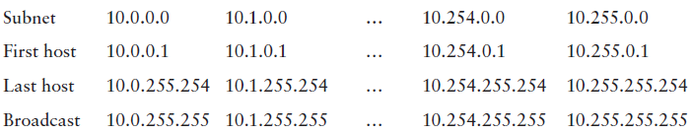
The following table shows the first two and the last two subnets, the valid host range and the broadcast addresses for the private Class A 10.0.0.0 network:

Slide 16
More subnetting examples
You have been allocated a class A network address of 29.0.0.0. You need to create at least 20 networks and each network will support a maximum of 160 hosts. Would the following two subnet masks Work? 255.255.0.0 and or 255.255.255.0
You have been allocated a class B network address of 135.1.0.0 and need to create 4 subnets each with around 200 hosts what is the easiest mask to use to satisfy the criteria?
Write the IP address 222.1.1.20 mask 255.255.255.192 in CIDR notation
Write the IP address 135.1.1.25 mask 255.255. 248.0 in CIDR notation
Subnet the Class C IP Address 195.1.1.0 So that you have 10 subnets each with a maximum 12 hosts on each subnet. List the Address on host 1 on subnet 0,1,2,3,10

Slide 17
6. Subnet the Class C IP Address 205.11.2.0 so that you have 30 subnets.
What is the subnet mask for the maximum number of hosts?
How many hosts can each subnet have?
What is the IP address of host 3 on subnet 2 ?
7. 192.168.60.55/20 find
Network ID
Broadcast ID
Usable IPs

Slide 18
6. 172.10.85.60/22
Network ID
Broadcast ID
Usable IPs
7. 172.10.60.16/29
Network ID
Broadcast ID
Usable IPs

Slide 19
Variable Length Subnet Masks (VLSM)
A serious limitation of using only a single subnet mask across a given network prefix (the number of network or 1 bits in the mask) was that an organization is locked into a fixed number of fixed sized subnets.
VLSM enables a network number to be configured with different subnet masks on different interfaces.
  Subnet an already subnetted network address.
  Conserves IP addresses.
  More efficient use of available address space.
Allows for more hierarchical levels within an addressing plan.
VLSM is the process of breaking down subnets into smaller subnets, according to the need of individual networks.

Slide 20
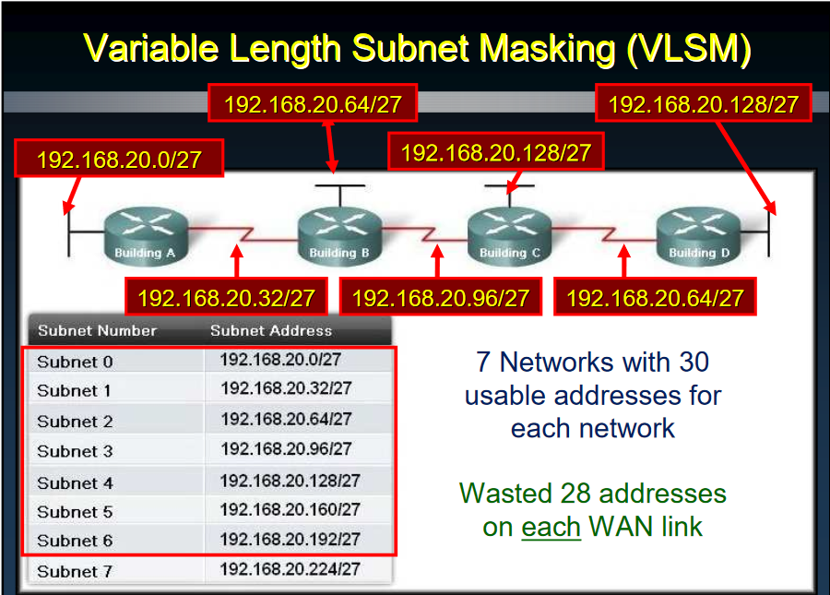

Slide 21
If you know how to subnet, you can do VLSM. What’s the trick?
Always satisfy the requirements of your biggest LAN and then work your way down
Steps for VLSM
List the number of hosts required per network beginning with the largest to the smallest.
Convert the subnet mask to binary.
Draw a line where the network portion ends.
Ask yourself the question How many bits do I need to support the required number of hosts?
Move the line to show your new network portion.
Determine your new magic number.
Finish subnetting using the new magic number.

Slide 22
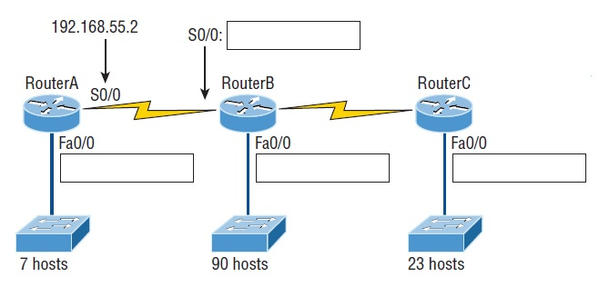
VLSM network example 01
192.168.55.0

Slide 23
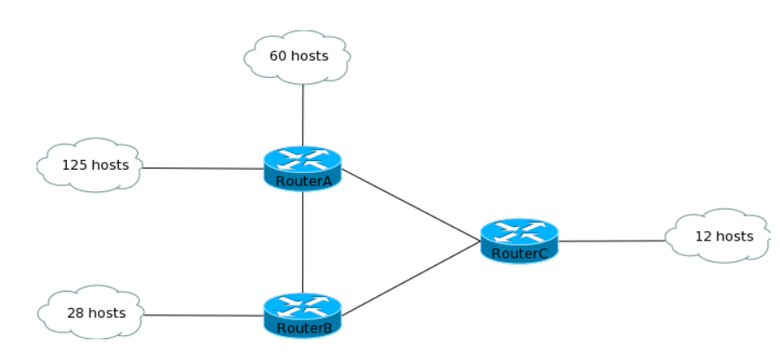
Example 02
192.168.1.0/27

Slide 24
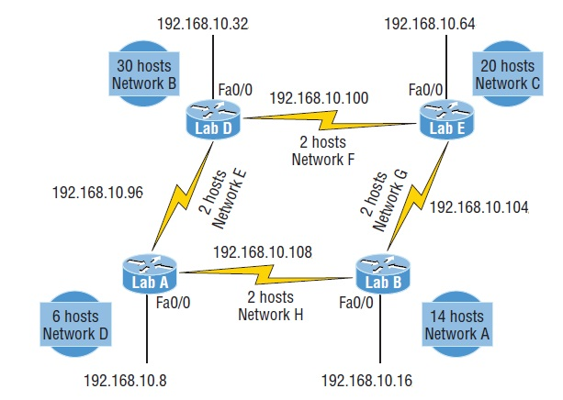
VLSM network example 03

